Slide 1
HOSTEL MANAGEMENT SYSTEM

Slide 2


TEAM
180041117
180041122
180041123
FAYSAL MAHMUD
MD. ASHRAFUL ISLAM
MD. ATIQUR RAHMAN

Slide 3
INTRODUCTION

Slide 4
WHY?
MANAGING A HOSTEL EFFICIENTLY
MAINTAING PRECAUTION DURING CRYSIS SITUATION

Slide 5
INTRODUCTION
MAINTAINING SOCIAL DISTANCE
STORING AND RETRIVING INFORMATION EFFICIENTLY
NOT ONLY FOR MANAGER BUT ALSO FOR EVERY EMPLOYEE
ALL SECURITY MEASURES ARE BETTER THAN ANALOGUE SYSTEM WITH THIS PROJECT

Slide 6

CHALLANGES
2

Slide 7
CHALLENGES
DECIDING WHICH TYPE OF FILE SYSTEM WE WANT TO IMPLEMENT IN OUR PROJECT
GETTING SAME VALUES FROM DIFFERENT CLASSES
PROBLEM IN NEW AND DELETE OPERATOR
PROBLEM DUE TO IMPLEMENTING GRAPHICS IN DIFFERENT SYSTEM

Slide 8
FUTURE WORKS

Slide 9
FUTURE WORKS
IMPLEMENTING NEW PAYMENT SYSTEM
BRANCHING OUT THE HOSTEL MANAGEMENT SYSTEM
ADDING DATABASE IN THE SYSTEM
INTRODUCING NEW CONSTRAINTS

Slide 10
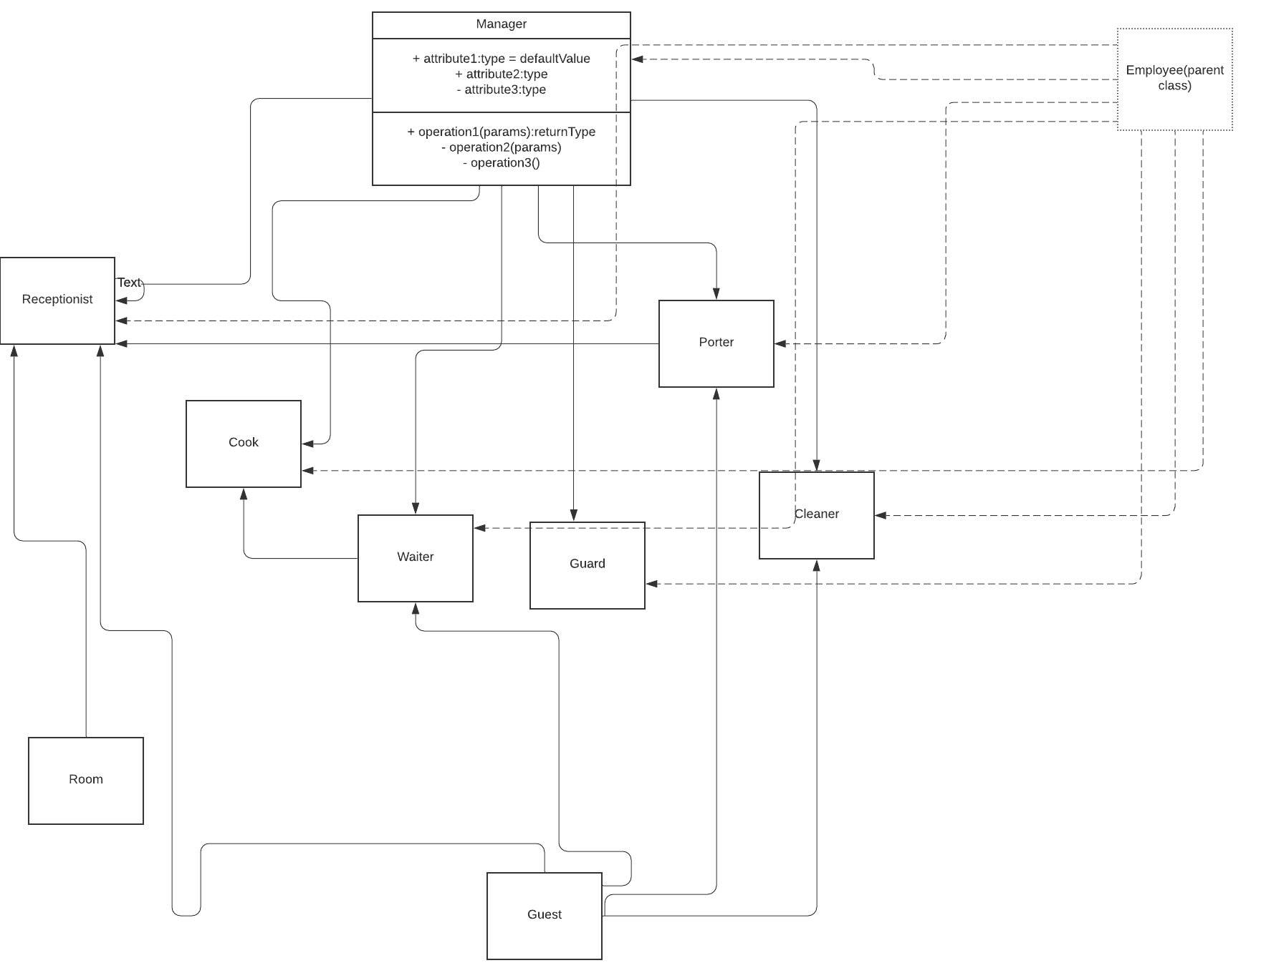
UML CLASS DIAGRAM

Slide 11
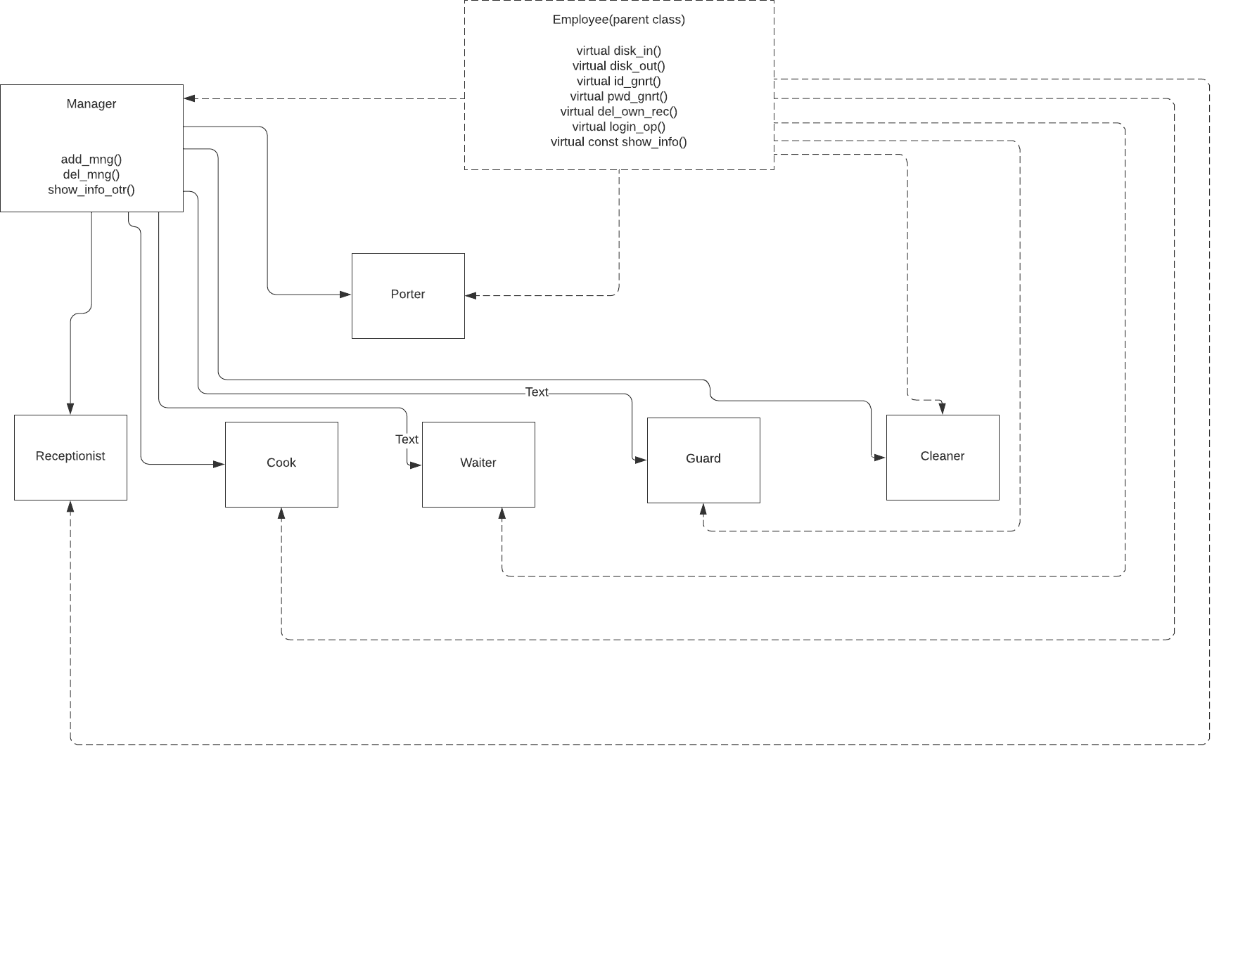
STORYLINE BETWEEN MANAGER AND OTHERS

Slide 12
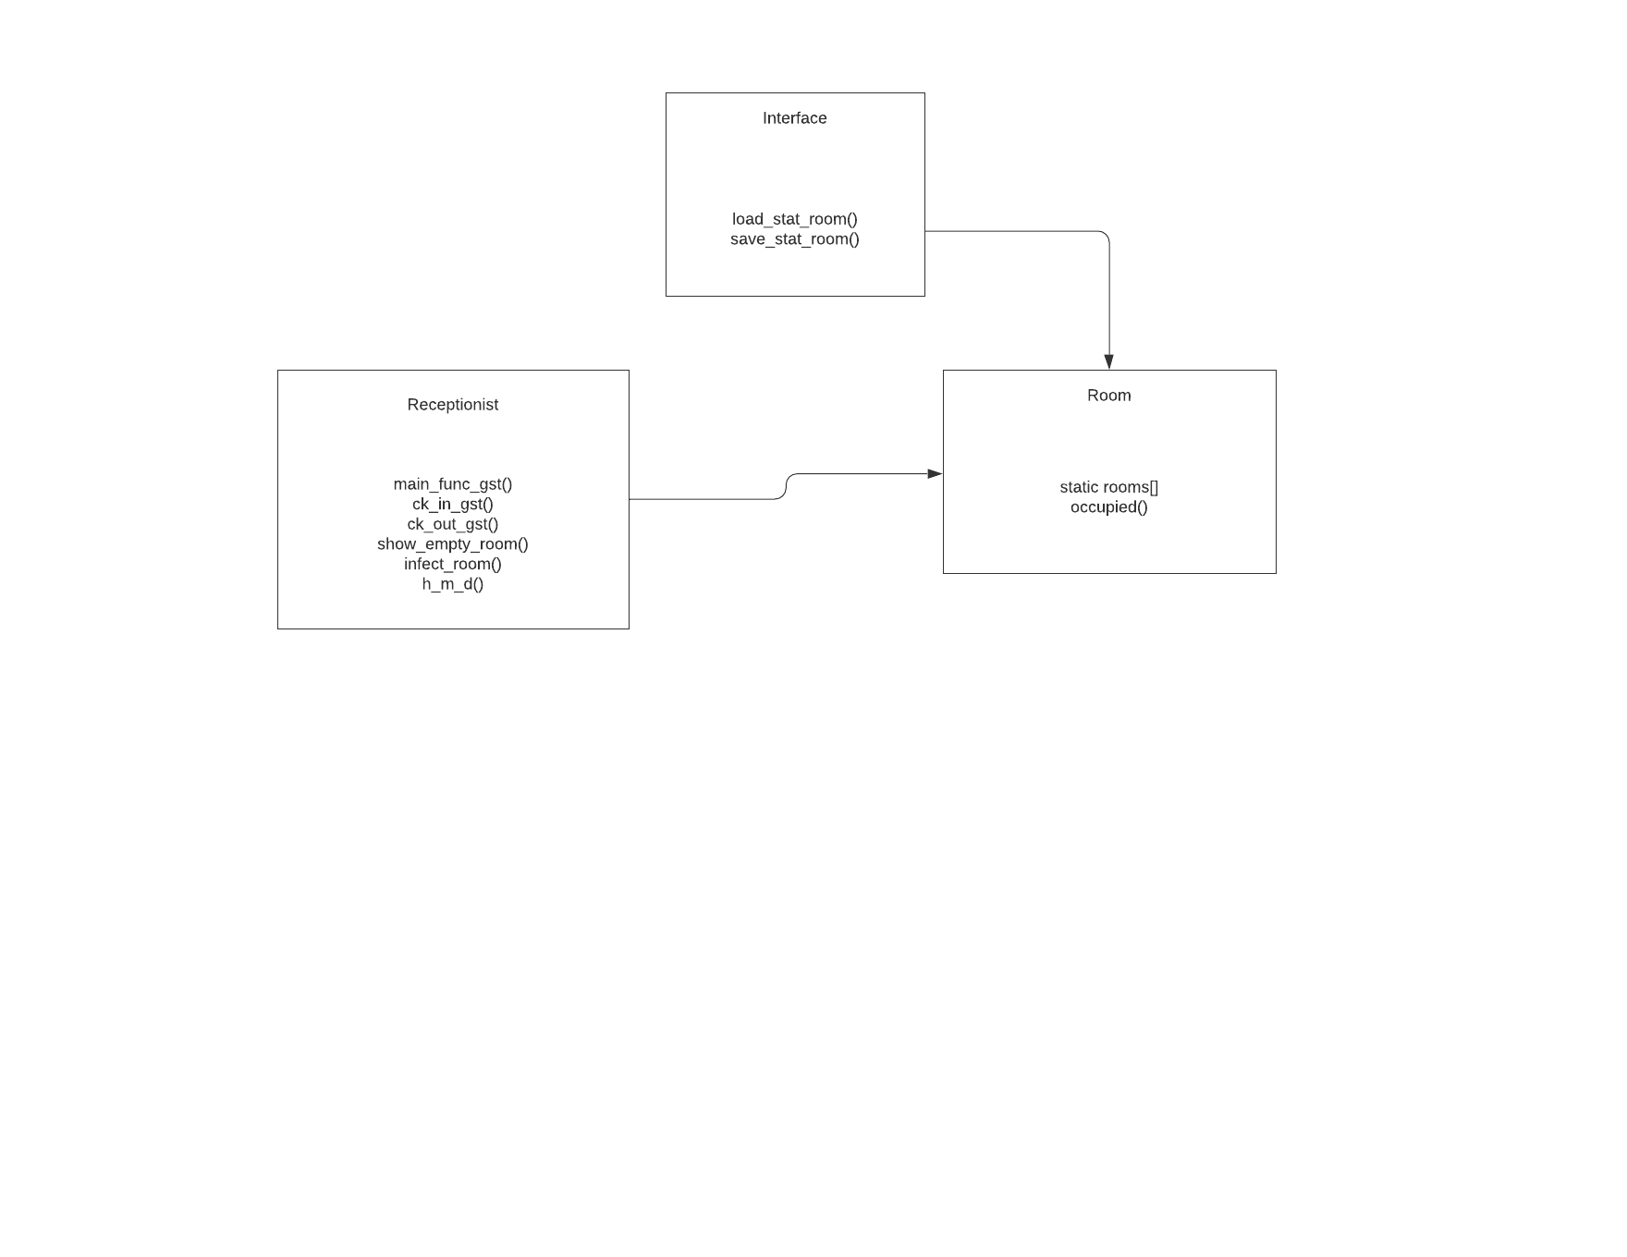
STORYLINE AMONG RECEIPTIONIST, INTERFACE AND ROOM

Slide 13
UML CLASS DIAGRAM

Slide 14
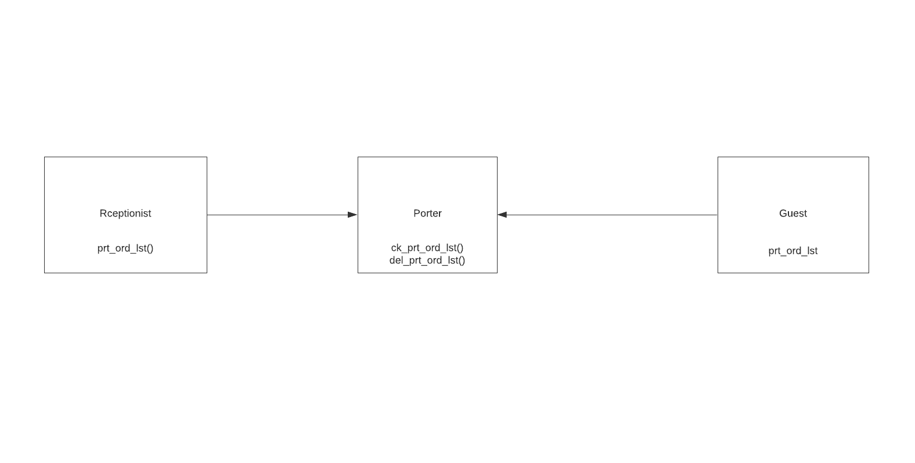
STORYLINE AMONG GUEST, RECEIPTIONIST & PORTER

Slide 15
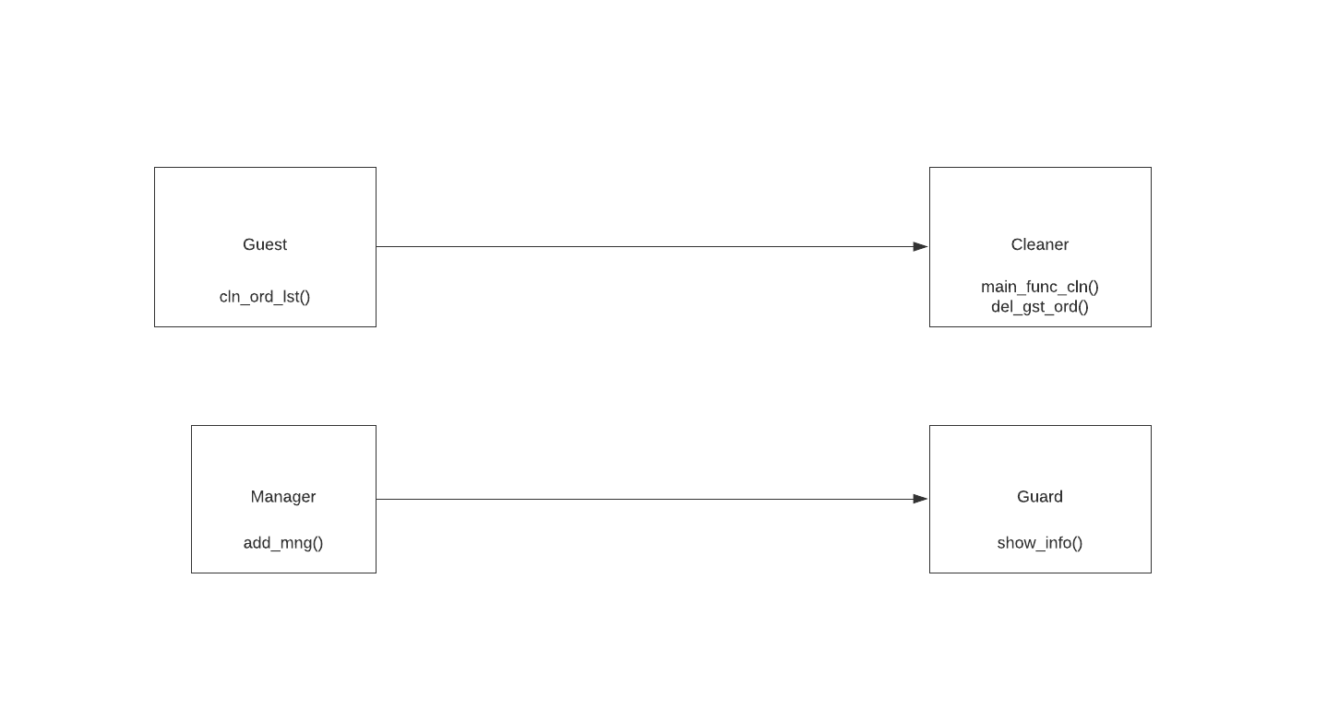
STORYLINE AMONG GUEST & CLEANER, MANAGER & GUARD

Slide 16
STORYLINE OF FONT WITH OTHERS

Slide 17
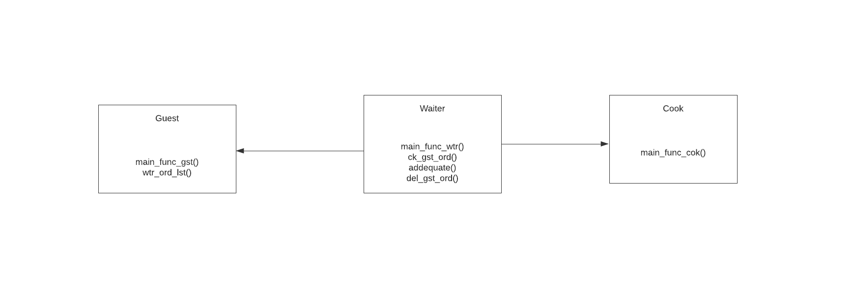
STORYLINE AMONG GUEST, WAITER AND COOK

Slide 18
THANK YOU!

